Slide 1

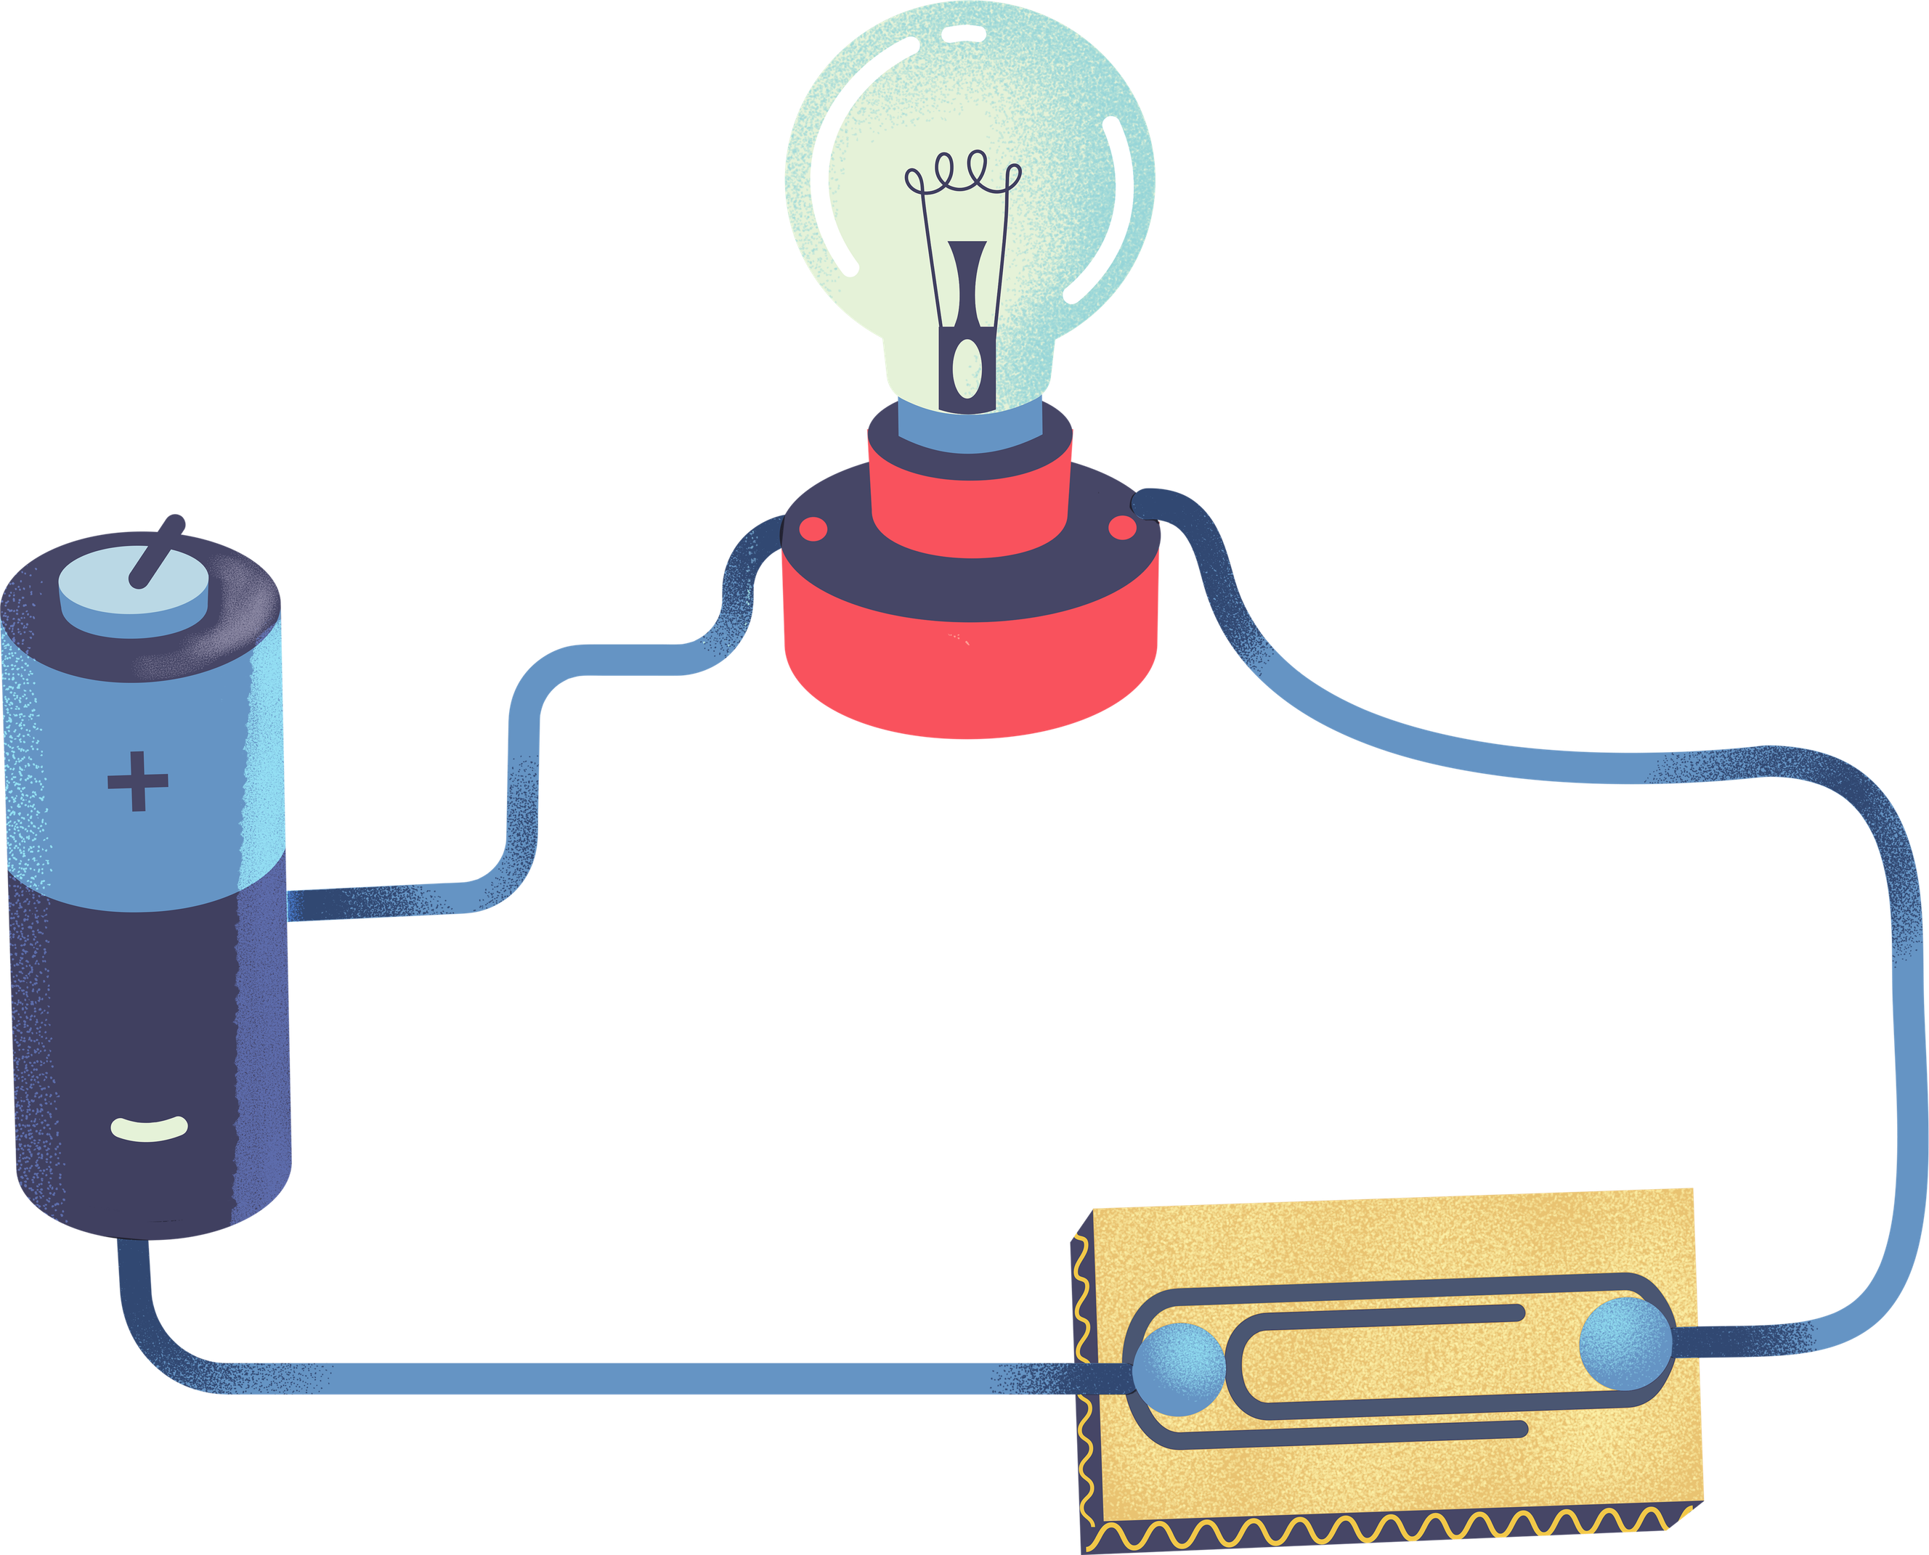
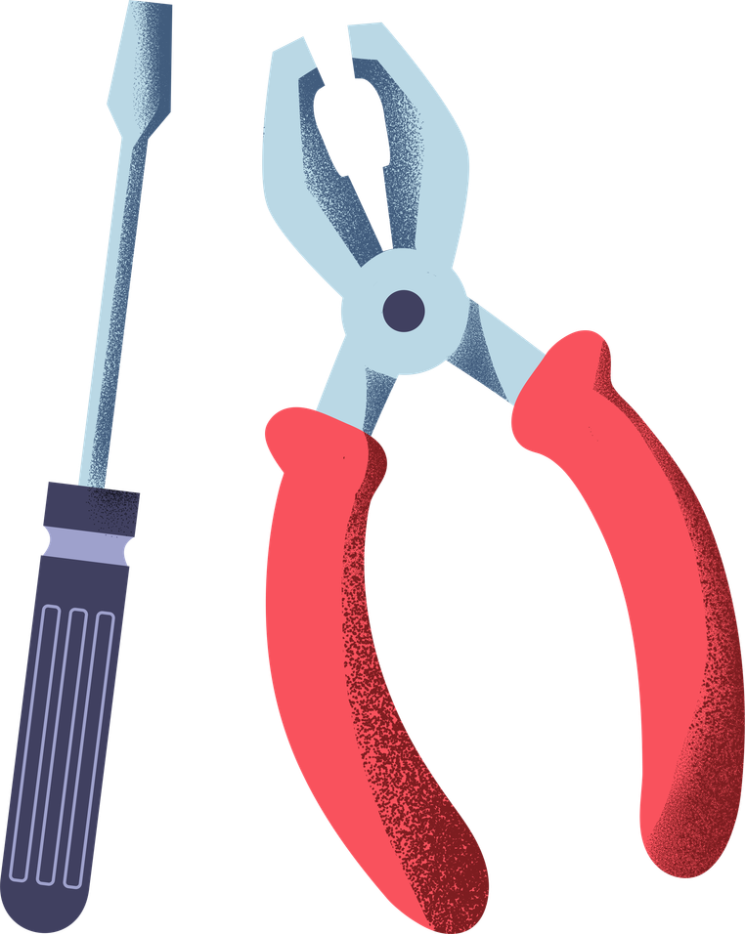
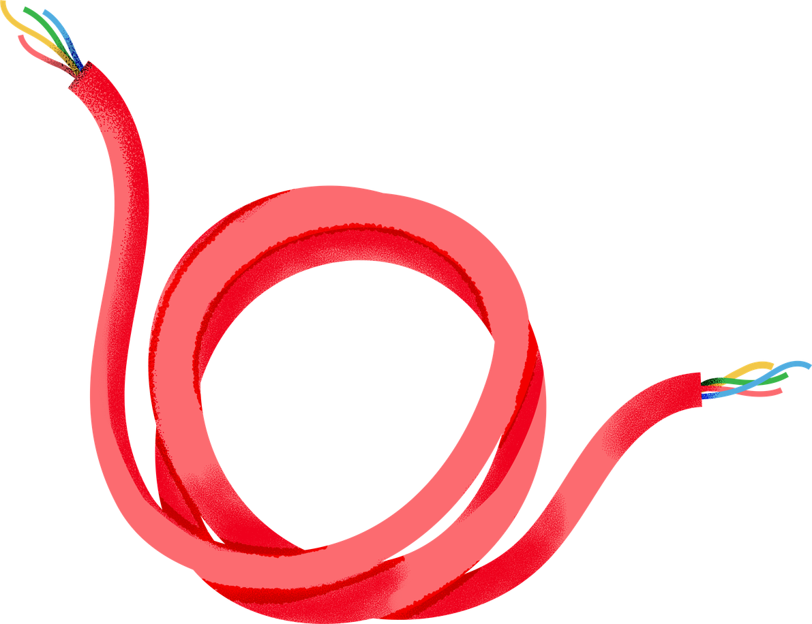
LET’S BUILD CIRCUITS

Slide 2
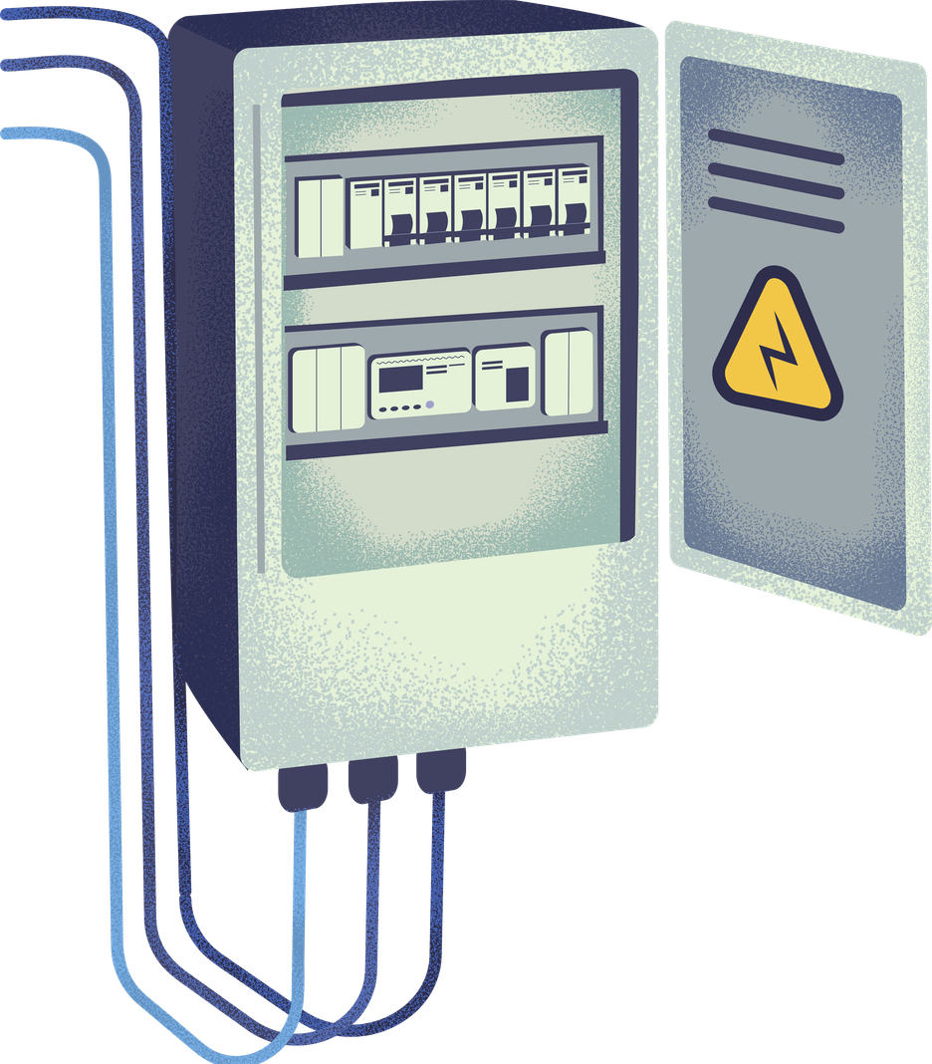
Electricity and Circuits
Electrical energy is one of the most common and most useful forms of energy. Circuits in electrical devices allow electricity use with a flip of a switch.

Slide 3
THINK ABOUT IT
How do circuits work?
What are the different types of circuits?
What are the components of different circuit types?

Slide 4
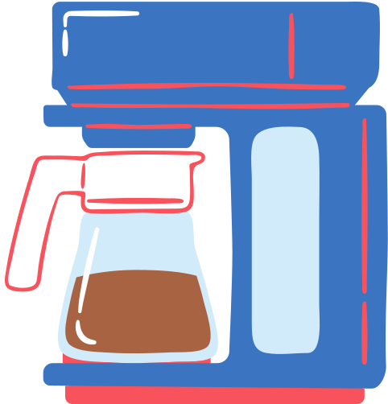


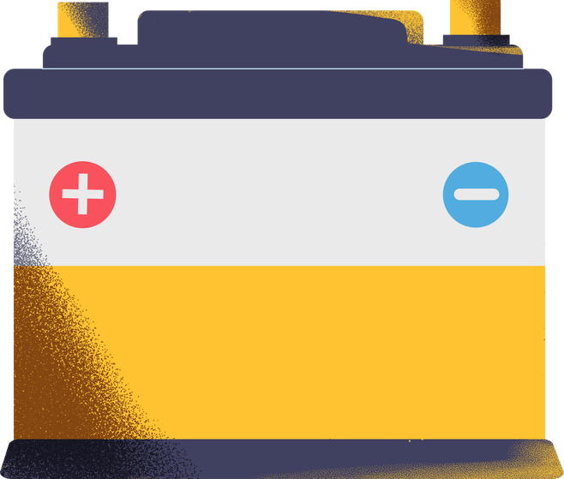
What makes a circuit?
Electrical device
Conductor
Voltage source
Switch
material that allows current to flow
controls the current flow
converts electrical energy into another form
source of electricity, such as batteries or electric outlets

Slide 5
Activity Instructions
1
Build a diagram of the different kinds of circuits.
2
Use the illustrations on the page. Duplicate them as needed.
3
Use arrows to show the flow of energy.
4
Identify the type of energy the electric energy is converted to.

Slide 6



Simple Open Circuit
The switch is off, no current flows and no energy is converted.
Press the "/" key and look for the draw tool to create your wires.

Slide 7
Simple Closed Circuit
The switch is on, allowing the current to flow and use energy to power a device.
Press the "/" key and look for the draw tool to create your wires.

Slide 8
Series Circuit
It has a single loop where current flows. All devices are connected in the loop.
Press the "/" key and look for the draw tool to create your wires.

Slide 9
Parallel Circuit
It has two or more loops where current flows. Each loop is independent of the other.
Press the "/" key and look for the draw tool to create your wires.

Slide 10
Short Circuit
Current travels through a shorter and unintended pathway with low resistance.
Press the "/" key and look for the draw tool to create your wires.

Slide 11

Answer Key
Switch off
Switch on
Simple Open Circuit
Simple Closed Circuit
Series Circuit
Switch on
Parallel Circuit
Short Circuit

Slide 12



Resource Page
Use these icons and illustrations in your Canva Presentation.
Happy designing! Don’t forget to delete this page before presenting.

Slide 13



Try this background for online class.
*Please delete this section before downloading.

Slide 14
Press these keys while on Present mode!
B
for blur
C
for confetti
D
for a drumroll
M
for mic drop
O
for bubbles
Q
for quiet
U
for unveil
Any number from
0-9 for a timer

